Slide 1

CAP 6317/4773: Social Media Mining
Lecture 8: Network Models
Raiyan Abdul Baten, Ph.D.
February 1, 2024

Slide 2
Recap

Slide 3
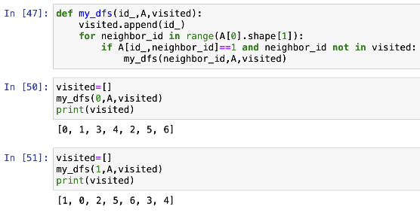
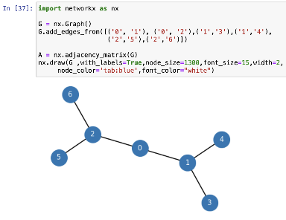

Slide 4
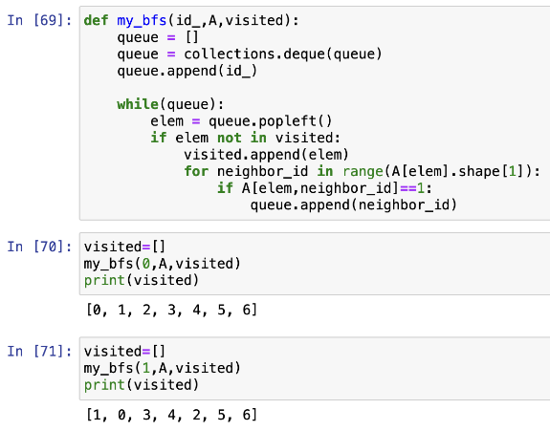


Slide 5
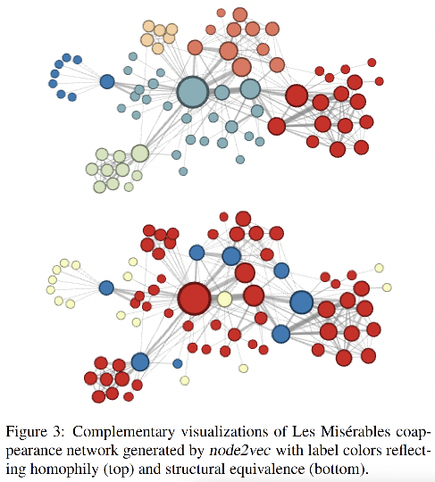
Which nodes are similar to each other?

Slide 6
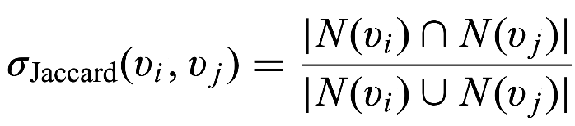

Capturing Structural Equivalence
N is the set of neighboring nodes

Slide 7
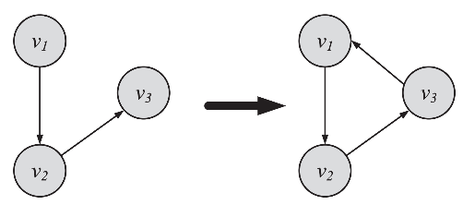
Transitive Linking
When a friend of my friend is my friend

Slide 8
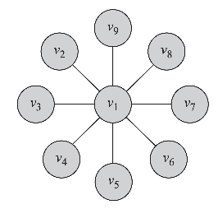
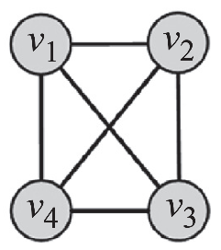
Data Mining Task: How Prevalent is Transitivity in your Data?
No triangle is closed
Clustering Coeff = 0
Example: Star Graph
All triangles are closed
Clustering Coeff = 1
Example: Fully Connected Graph

Slide 9
Local Clustering Coefficient
To what extent are my friends, friends with each other?
v_{i}
v_{i}
v_{i}
v_{i}
C(v_{i}) = 0
C(v_{i}) = 1/3
C(v_{i}) = 2/3
C(v_{i}) = 1

Slide 10
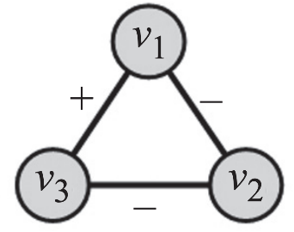

Does your data show Social Balance?
We have social balance if
w₁₃= +1
w₂₁= -1
w₃₂= -1

Slide 11
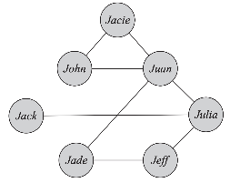
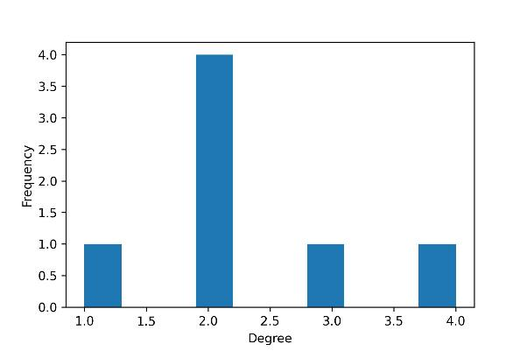
Node
Degree
Jacie
John
Juan
Jack
Julia
Jade
Jeff
2
2
4
1
3
2
2

Slide 12
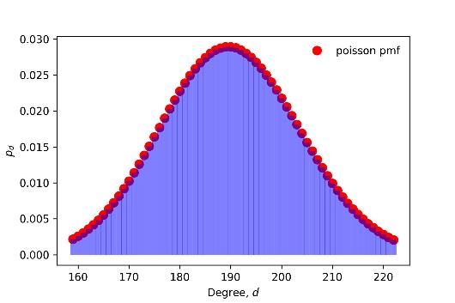
Let’s look at Facebook data
p_{d} in a random graph with the same number of nodes and edges
Facebook on May 2011:
721 million users/nodes
Each user has 190 friends on average
A total of of 68.5 billion friendship edges

Slide 13
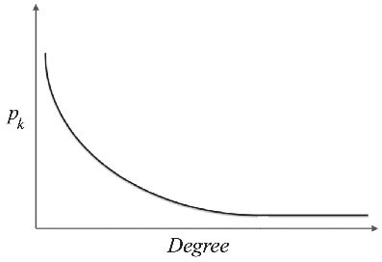
Let’s look at Facebook data
How p_{d} in the actual data looks like
Facebook on May 2011:
721 million users/nodes
Each user has 190 friends on average
A total of of 68.5 billion friendship edges

Slide 14


The Power-Law Distribution
p_{k} denotes the fraction of people with degree k.
Then, the Power-Law distribution is
Taking the log on both sides,

Slide 15


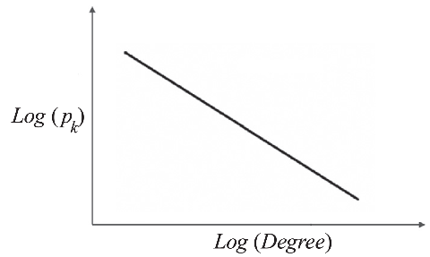
The Power-Law Distribution

Slide 16
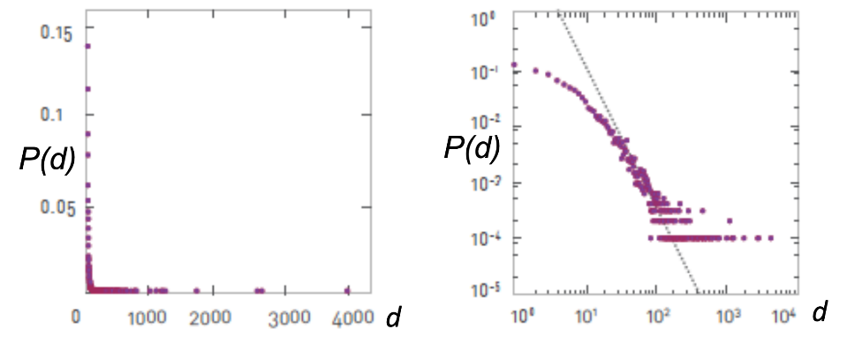

Slide 17
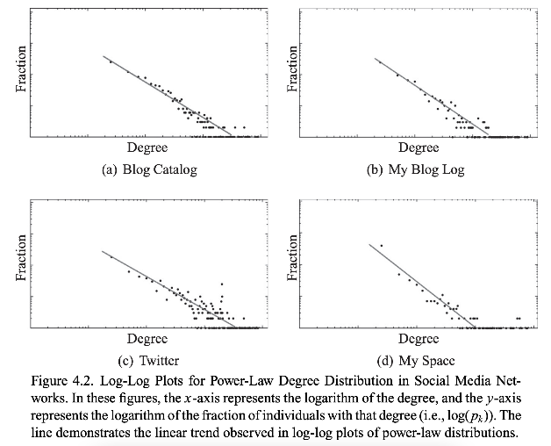

Slide 18
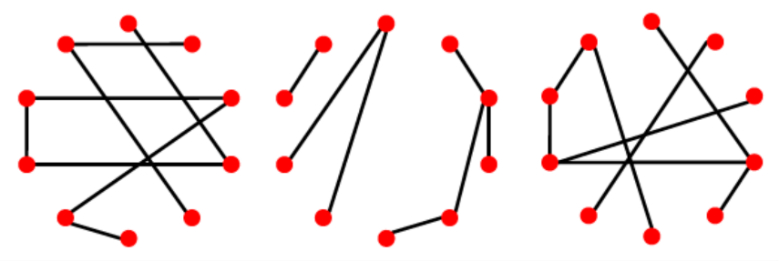

Slide 19
Approach 1: G(n,p)
Number of nodes, n, is fixed
A pair of nodes have an edge with probability p

Slide 20
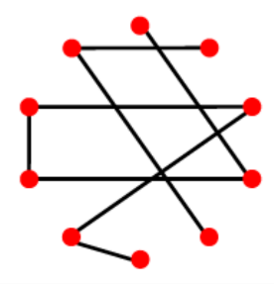
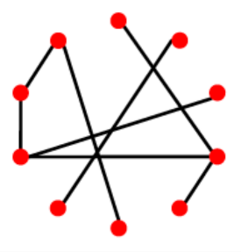
Approach 2: G(n,m) Erdos-Renyi Random Graph
Number of nodes, n, is fixed
Number of edges, m, is also fixed
Randomly assign which node-pairs will have those edges

Slide 21
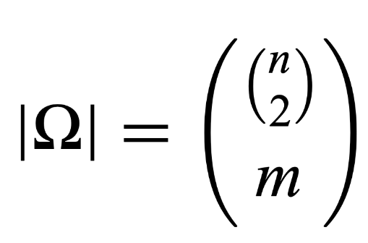
(n choose 2) possible edges
Choose m edges out of those

Slide 22
Questions?

Slide 23
Pop Quiz

Slide 24
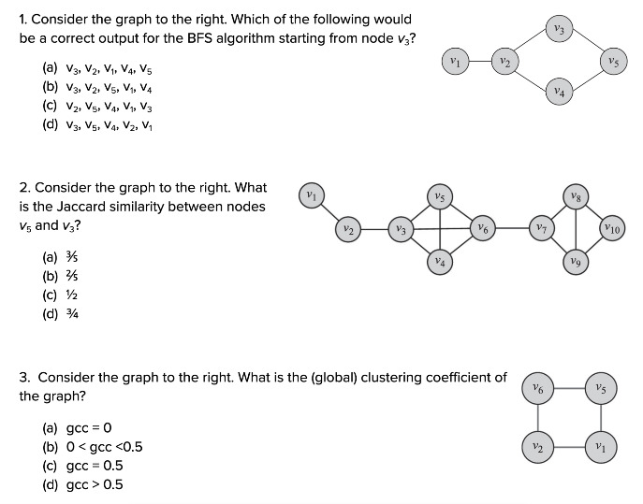

Slide 25
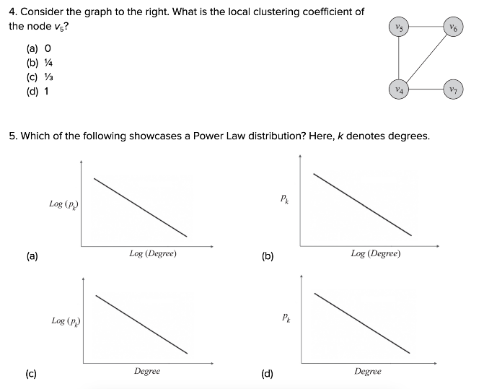

Slide 26
Reminder to self: Attendance

Slide 27
Reading for today’s lecture: 4.1, 4.2, 4.4

Slide 28
Random
Graphs

Slide 29
Let’s look at Facebook data
p_{d} in a random graph with the same number of nodes and edges
Facebook on May 2011:
721 million users/nodes
Each user has 190 friends on average
A total of of 68.5 billion friendship edges

Slide 30
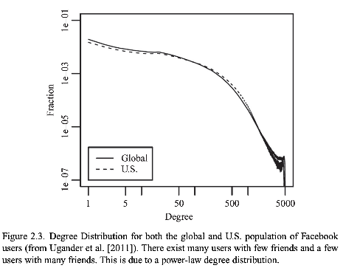
Let’s look at Facebook data
p_{d} in the actual data
Facebook on May 2011:
721 million users/nodes
Each user has 190 friends on average
A total of of 68.5 billion friendship edges
Ugander, J., Karrer, B., Backstrom, L., & Marlow, C. (2011). The anatomy of the Facebook social graph. arXiv preprint arXiv:1111.4503.

Slide 31
Approach 1: G(n,p)
Number of nodes, n, is fixed. A pair of nodes have an edge with probability p
What is the average degree per node?

Slide 32
Average degree per node in G(n,p)
A node can connect to at most (n-1) possible peers

Slide 33
Average degree per node in G(n,p)
A node can connect to at most (n-1) possible peers
Out of those, p edges will be realized on average
p
p
p
p
p
p

Slide 34
Average degree per node in G(n,p)
A node can connect to at most (n-1) possible peers
Out of those, p edges will be realized on average
So, Average degree per node, c = (n-1)p
p
p
p
p
p
p

Slide 35

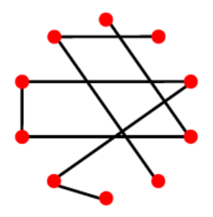
Expected number of edges in G(n,p)
We have ways of picking a pair of nodes

Slide 36
Expected number of edges in G(n,p)
We have ways of picking a pair of nodes
Out of those, p fraction will be realized

Slide 37
Expected number of edges in G(n,p)
We have ways of picking a pair of nodes
Out of those, p fraction will be realized
So, Average number of edges, m = p

Slide 38
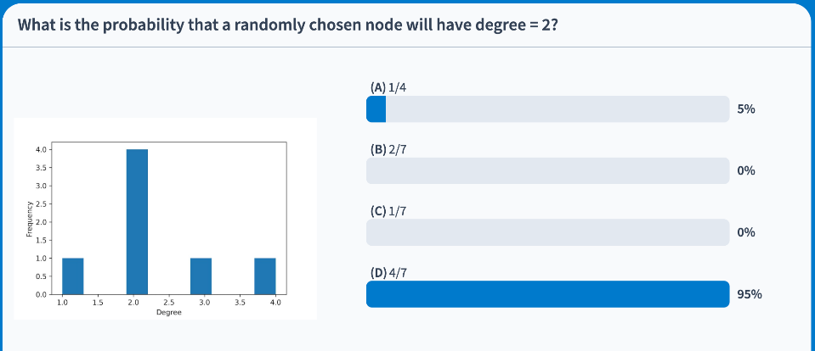



Slide 39
What is the probability that a certain node has degree d?
A node can connect to at most (n-1) possible peers
p
p
p
p
p
p
The gray node can connect to (4-1)=3 peers

Slide 40

What is the probability that a certain node has degree d?
A node can connect to at most (n-1) possible peers
Out of those, d edges can be chosen ways
p
p
p
p
p
p
Out of those, d=2 edges can be chosen
(3 choose 2) = 3 ways

Slide 41

What is the probability that a certain node has degree d?
A node can connect to at most (n-1) possible peers
Out of those, d edges can be chosen ways
Probability of having exactly d degrees:
p
p
p
p
p
p

Slide 42
What is the probability that a certain node has degree d?
A node can connect to at most (n-1) possible peers
Out of those, d edges can be chosen ways
Probability of having exactly d degrees:
p
p
p
p
p
p
The gray node can have d=2 in 3 different ways

Slide 43
What is the probability that a certain node has degree d?
A node can connect to at most (n-1) possible peers
Out of those, d edges can be chosen ways
Probability of having exactly d degrees:
p
p
p
p
p
p
With p=0.5, we can have d=2 edges form with probability (0.5)²

Slide 44
What is the probability that a certain node has degree d?
A node can connect to at most (n-1) possible peers
Out of those, d edges can be chosen ways
Probability of having exactly d degrees:
p
p
p
p
p
p
The rest of (n-1-d) edges cannot form, each happening with probability (1-p)

Slide 45



Slide 46

Take the limit n → ∞ to get the degree distribution for a very large graph:

Slide 47

Take the limit n → ∞ to get the degree distribution for a very large graph:

Slide 48
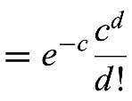


Slide 49
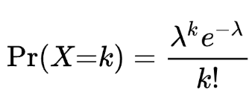

Slide 50
This is the Poisson Distribution!

Slide 51

Intuition behind the Poisson Distribution
You know the average rate, c, of events happening independently
The Poisson Distribution will tell you the probability of the event happening d number of times within the unit time/space

Slide 52
Intuition behind the Poisson Distribution
Average rate of calls coming to a call center, c = 3 per minute
Probability of getting exactly d = 2 calls in a minute is
(3² e⁻³)/ 2! = 0.22

Slide 53
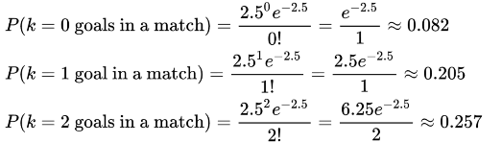
Intuition behind the Poisson Distribution
Average number of goals in a World Cup match c = 2.5 per match
Probabilities of getting exactly d = 0, 1, 2 goals in a match are
d
d
d

Slide 54
Let’s look at Facebook data
p_{d} in a random graph with the same number of nodes and edges
Facebook on May 2011:
721 million users/nodes
Each user has 190 friends on average
A total of of 68.5 billion friendship edges

Slide 55
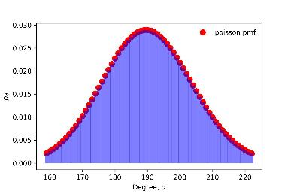
So.. a random graph has Poisson Degree Distribution
Average number of friends on facebook, c = 190 per node
Probabilities of finding nodes with exactly d = 0, 1, 2,... 190, … 5000 friends

Slide 56
A more realistic version: Barabasi-Albert Model
Attempt 1:
Hold network size, n, constant
Inject preferential attachment:
Connect to a vertex v_{j} with probability proportional to v_{j}’s degree centrality

Slide 57
A more realistic version: Barabasi-Albert Model
Attempt 2:
Allow n to grow: add new nodes!
But connections are random

Slide 58
A more realistic version: Barabasi-Albert Model
Attempt 3:
Allow n to grow: add new nodes!
Inject preferential attachment:
Connect to a vertex v_{j} with probability proportional to v_{j}’s degree centrality

Slide 59
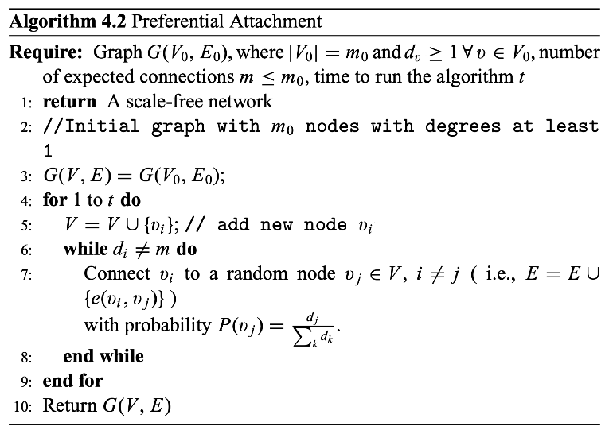

Slide 60
Summary

